Slide 1

Zomato Sales Analysis
Pragati Kabra

Slide 2

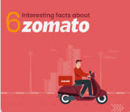
Around 2008, people in Delhi were fed up with manual searching of delivery menus of different restaurants around them. Deepinder Goyal and Pankaj Chaddah, the founders of Zomato made the most of this opportunity by launching a food directory service. They called it FoodieBay. In just 9 mthm, it became the largest and a popular restaurant directory in all of Delhi.
It’s revenue grew from Rs. 1,300 cr. in FY 2019 to Rs. 2,800 cr. in FY 2020. It is already profitable at EBITDA level in the food delivery business. During Q2 2019, it was burning about Rs. 290 cr. every month

Slide 3

PROBLEM STATEMENT
±To identify optimal countries and cities for opening new restaurants by analysing existing restaurant performance, market demand, and economic factors, ensuring profitable and strategic expansion.

Slide 4

Data Cleaning and Processing
Total 15 countries, restaurant name, locality, cuisines it offer.
Dataset contains information about restaurant name, id, locality, longitude, latitude, date of opening,currency used, average cost of two, has online delivery service available or not
Data Cleaning and processes
Cuisines contains some null values which is handled by ifblank
Normalized currency with average cost of two people
Standarized date format in readable format
Processed various currencies and converted them into INR and USD for comparison.
Used LOOKUP functions to fetch the appropriate country codes.

Slide 5
Methodology
Data Cleaning - Using ifna() , trim, clear function to handle missing values
Data Preprocessing - Enhanced dataset with additional column name of country extracted using VLOOKUP to cross reference external data sets
Data Enrichment - Applied CONCATENATE, MID, FIND function to attain customized price value using currency and price
Descriptive Analysis - Employed PIVOT table to summarize key metrics and identify count of restaurants in each country, cities and price of each. It also helps in understanding which restaurant is highly rated and what factors affect it.
Visualization - creating dynamic charts and dashboards for data visualization.

Slide 6
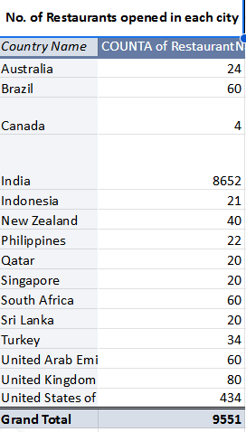
No. of Restaurants opened in each city
8,652 restaurants (90%+ of total) are in India, indicating a highly competitive food industry
434 restaurants are located in the USA, showing significant market presence.
Qatar & Sri Lanka Have Low Competition.Only 20 restaurants each → Indicating potential for new business expansion.These countries could be ideal for launching new restaurants with lower competition
Australia, Canada, Singapore, & New Zealand Have Minimal Presence .Fewer than 50 restaurants in each country → Scope for growth & expansion in these markets

Slide 7
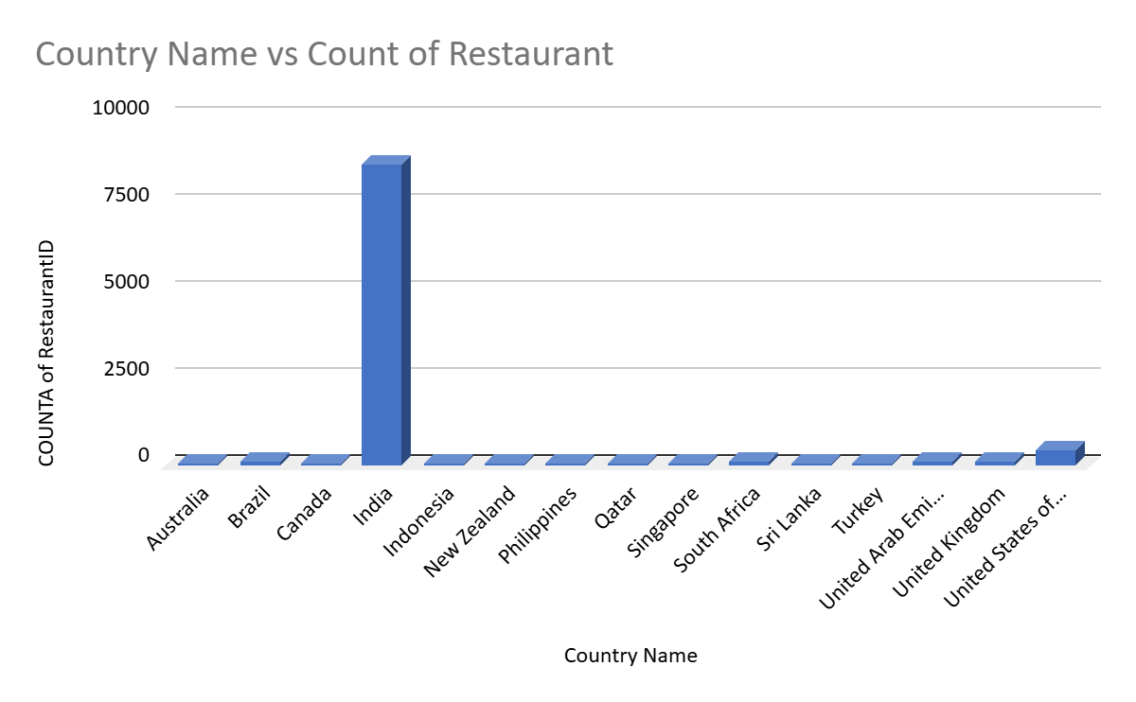

Slide 8
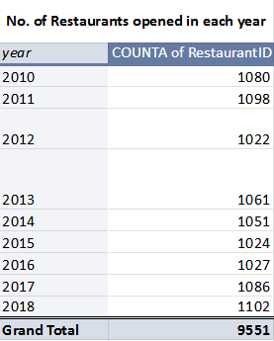
Restaurants opened each year
The number of restaurants opened each year remains relatively stable, averaging around 1,050 per year.Indicates a consistent demand for new restaurant ventures
2018 saw the highest number of restaurant openings, suggesting strong market confidence
2012 (1,022) and 2015 (1,024) had lower openings
A steady upward trend in recent years (2016-2018) indicates increasing opportunities for new restaurants.

Slide 9
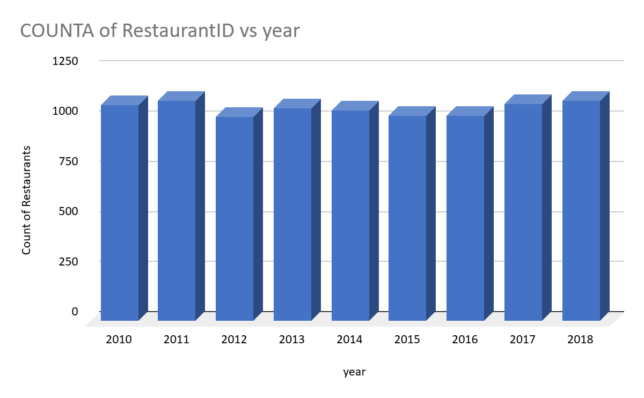

Slide 10
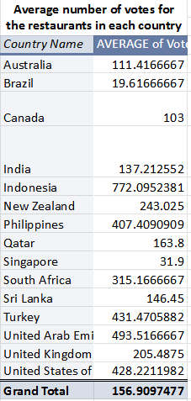
Indonesia Has the Highest Average Votes (772) which suggest higher engagement, indicating a strong food culture and active customer reviews.
United Arab Emirates (493) & Turkey (431) Also Show High Engagement. They have above-average customer voting patterns, suggesting strong customer interaction.
India Has a Moderate Voting Average (137).Despite India having the most restaurants (8,652), the average votes per restaurant remain moderate.This suggests either a dispersed market or less customer engagement in voting.
Countries with Low Engagement: Brazil (19), Singapore (31) Brazil & Singapore have the lowest average votes

Slide 11
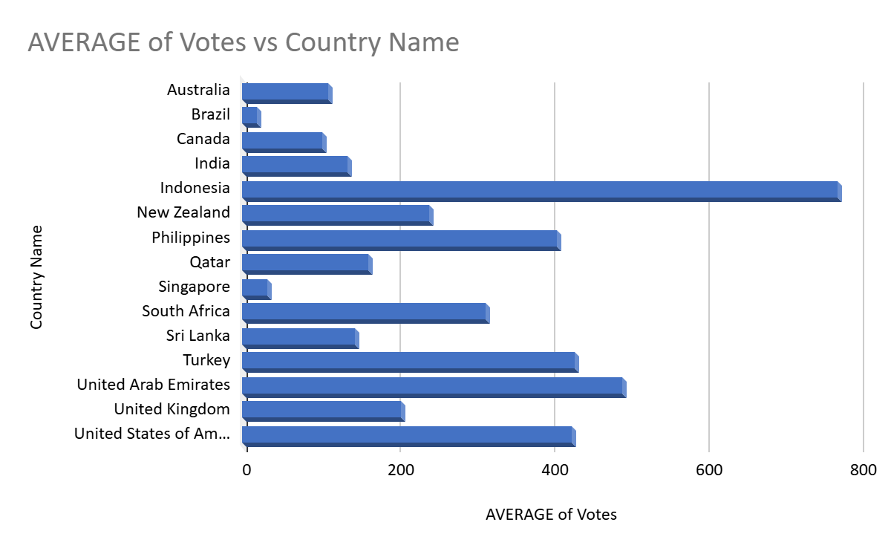

Slide 12
Total no. of Tables | 2
Total no. of Attributes | 22
categorical columns | 14
Total no. of Restaurants in price range of 4 | 388
Average rating for all restaurants that have price range less than 4 and provide online delivery | 3.27381151
count the number of restaurants listed that do not offer online delivery are in the lowest price range, and have an average cost for two people less than or equal to 250 Indian Rupees | 1694

Slide 13
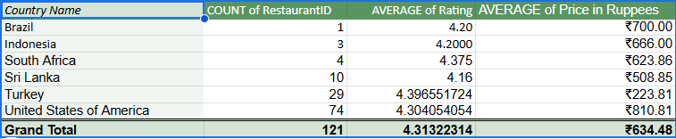
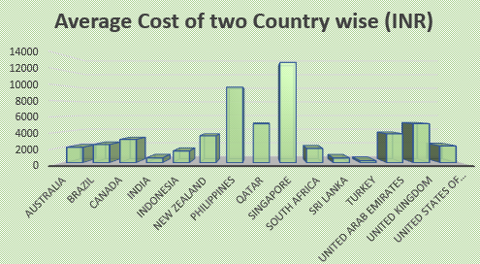
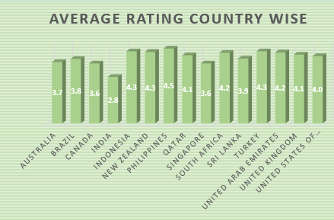
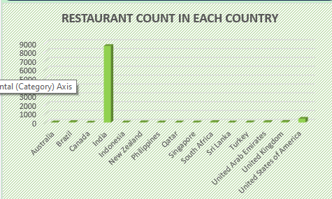
Countries where the team can open newer restaurants with lesser competition
The most suitable countries for opening new restaurants are those where:
The average ratings are higher than 3.9.
The total number of restaurants is less than 50.
The average cost of two is less than 820 rupees.

Slide 14
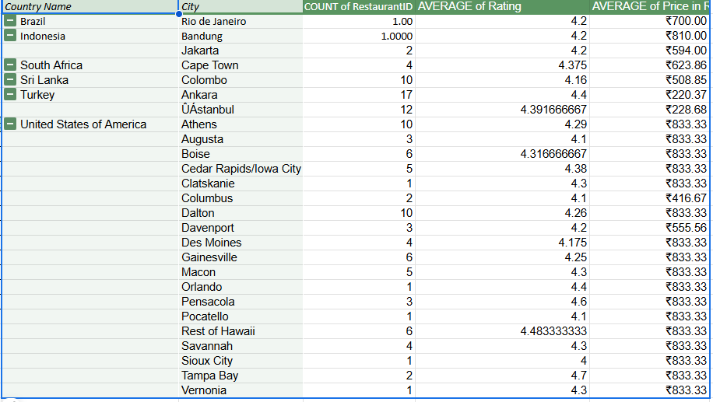
States and Cities for opening Restaurants
High-Rated & Low-Cost Locations: Cities like Ankara (Turkey) and Columbus (USA) have high average ratings (4.4+), while maintaining low average prices (₹220–₹416), making them prime locations for new restaurant openings.
Emerging Markets with Less Competition: Cities such as Rio de Janeiro (Brazil), Bandung (Indonesia), and Cape Town (South Africa) have very few restaurants but strong average ratings (above 4.2), indicating a gap in supply and an opportunity for market entry.
Affordable & Growing Demand Locations: Colombo (Sri Lanka) and Istanbul (Turkey) have relatively low dining costs (₹228–₹508) and decent average ratings, making them suitable for cost-efficient expansion.
Premium Market Opportunities in the USA: Cities like Tampa Bay, Rest of Hawaii, and Pensacola have the highest average ratings (above 4.4), but higher dining costs (₹833), suggesting potential for premium restaurant chains.
Strategic Entry Recommendation: Focus on Ankara, Colombo, Jakarta, and Cape Town for cost-efficient expansion, while targeting Tampa Bay, Rest of Hawaii, and Pensacola for premium dining opportunities.

Slide 15
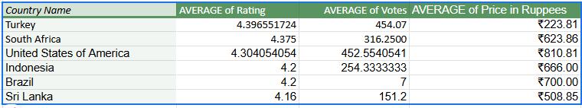
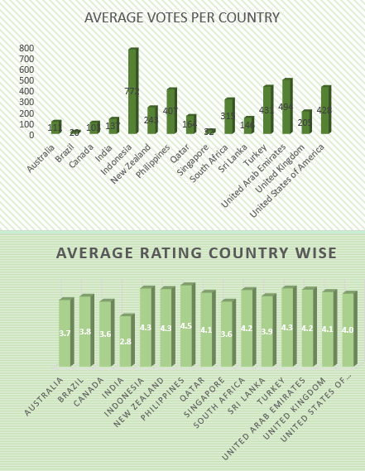
Current Quality regarding ratings for Restaurants
High-Quality Dining in Turkey & South Africa: Turkey (4.40) and South Africa (4.38) have the highest average ratings, indicating strong customer satisfaction and potential for high-end or mid-range restaurant expansion.
Strong Customer Engagement in Turkey & USA: Turkey and the USA have the highest average votes (~450), suggesting an active dining culture and reliable customer feedback, which helps in assessing market demand.
Affordable Dining in Turkey & Sri Lanka: Turkey (₹223) and Sri Lanka (₹508) have the lowest average dining costs, making them attractive for budget-conscious consumers and potential fast-casual restaurant chains.
Lower Competition in Brazil: Brazil has a lower average vote count (7), indicating either limited customer engagement or fewer established restaurants, making it a potential untapped market for new entrants.

Slide 16
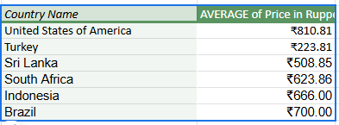
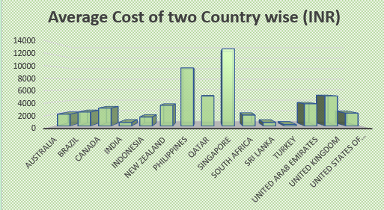
Current expenditure on food and measures to control
Highest Food Expenditure in the USA: The United States has the highest average dining cost (₹810.81), indicating a market suitable for premium restaurants and fine dining experiences.
Most Affordable Market in Turkey: Turkey has the lowest food expenditure (₹223.81), making it a prime location for budget-friendly or fast-casual dining options.
Moderate Costs in Other Countries: South Africa (₹623.86), Indonesia (₹666), Brazil (₹700), and Sri Lanka (₹508.85) fall within a moderate price range, providing flexibility for mid-range restaurant models.

Slide 17
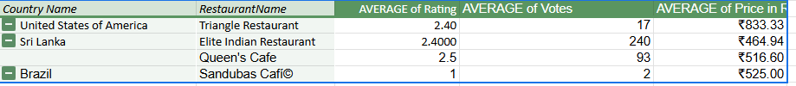
Names of restaurants from the recommended states that are our biggest competitors and also low rated
Low-rated competitors exist in key markets: Restaurants like Triangle Restaurant (USA), Elite Indian Restaurant (Sri Lanka), and Sandubas Café (Brazil) have ratings between 1-2.5, indicating poor customer satisfaction.
Low votes suggest limited customer engagement: With low review counts (e.g., Sandubas Café with just 2 votes), these restaurants may not have strong customer loyalty or visibility.
Pricing does not always justify quality: Despite mid-to-high pricing (₹464.94–₹833.33), these restaurants have poor ratings, suggesting service or quality issues.

Slide 18
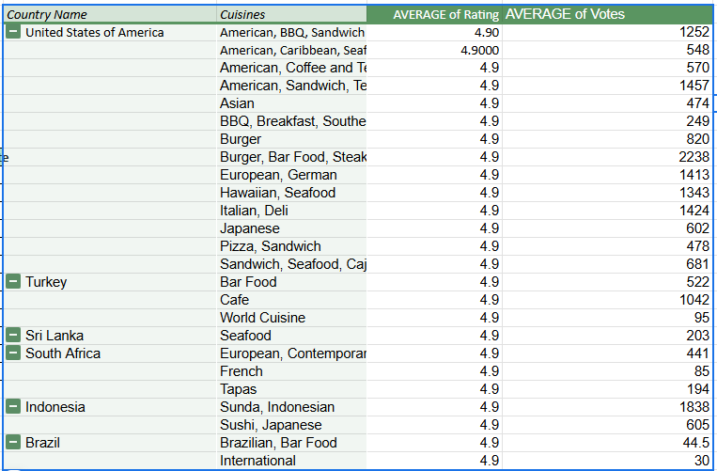
Cuisines with high rating
High-rated cuisines have strong customer appeal: Cuisines like American, BBQ, Sandwich (USA), Seafood (Sri Lanka), and Sunda, Indonesian (Indonesia) consistently receive 4.9 ratings, indicating strong customer satisfaction.
Diverse cuisines perform well across regions: A mix of local (Sunda, Indonesian, Brazilian) and international (European, Italian, Japanese, BBQ) cuisines receive top ratings, showing broad customer acceptance.

Slide 19
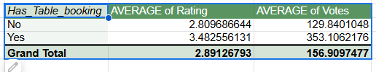
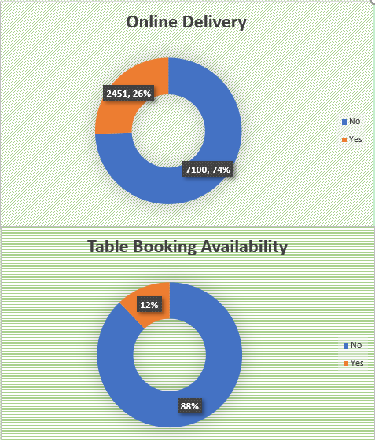

Effect of online delivery and table booking on ratings
Yes it affect customer rating
Insights
Online Delivery & Table Booking Can Impact Ratings
Higher Ratings for Restaurants with Online Services
Offering both delivery & table booking can increase customer engagement

Slide 20
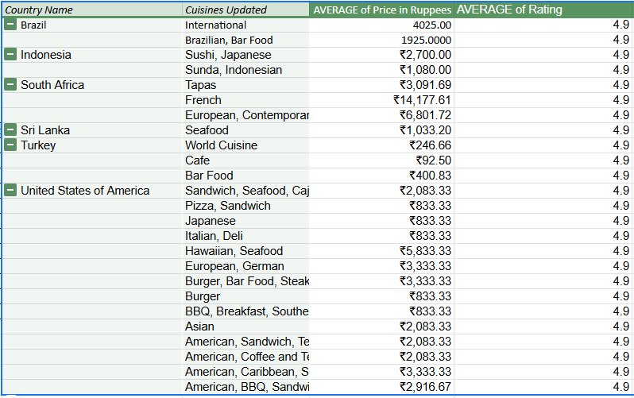
Effect of higher price on ratings
Insights
The correlation coefficient between cuisine rates and ratings is approximately 0.31, indicating a weak to moderate positive correlation. This suggests that while there is a slight relationship between higher cuisine rates and improved ratings, the impact is minimal.
A higher rate for cuisines may lead to a slight increase in ratings, but the effect is not significant enough to rely on pricing adjustments alone for improving customer feedback.
Recommendations
Given the weak correlation between cuisine rates and ratings, adjusting rates alone is unlikely to significantly impact customer feedback. Focus on improving quality and service to enhance overall customer satisfaction.

Slide 21
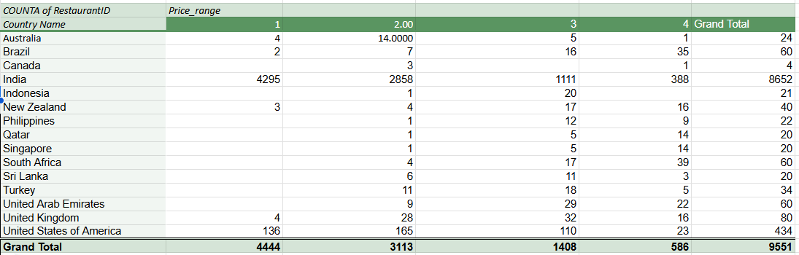
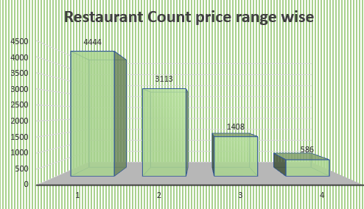
Restaurant Distribution according to price range
Insights-
India Dominates the Low-Price Market
Premium Dining is More Common in Brazil, Qatar, Singapore, and South Africa have a higher proportion of high-end restaurants (Price Range 4).
Canada, Indonesia, Philippines, Qatar, and Singapore have very few or no restaurants in Price Range 1
The United States and the United Kingdom show a relatively balanced spread across all price ranges, indicating diverse customer preferences.

Slide 22
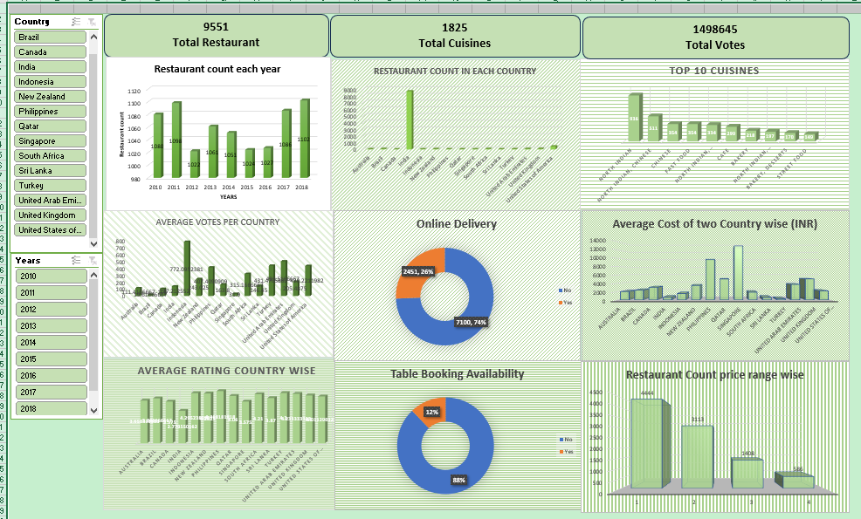
DASHBOARD

Slide 23
CONCLUSION
The selected countries and cities are based on the following criteria: each has fewer than 100 existing restaurants, average ratings of 3.9 or higher, an average expenditure of less than $60 for two people, and a minimum of 150 voters. These factors indicate strong market potential and favourable conditions for new restaurant openings.
South Africa: Cities like Cape Town, Johannesburg, Pretoria, Randburg, and Sandton are ideal for new restaurants, with a strong customer base and high average ratings.
Sri Lanka: Colombo stands out as a prime location, meeting all criteria for restaurant expansion with favourable ratings and manageable expenditure.
Turkey: Ankara and Istanbul are highly suitable, offering good ratings and reasonable costs, making them strategic choices for new ventures.
Brazil : Rio de janerio is highly suitable, offering rating of 4.2 and less competition
Indonesia : Bandung and Jakarta are best location for opening restaurant, with average rating of 4.2
United States of America - It provides vast market to expand with various cities like Dalton, Macon etc. and average price of two person is also low

Slide 24
THANK YOU

